Slide 1

- Shaker Alzaidy.
- Mohammed Alkhudhayr.
- Thamer Alfhead.

Slide 2
What is ReferME?
- Website & app
It is a website & app to support students in their college life. Its purpose Is to enhance the student experience (academic and social). Also, it ensures the students growth and development during their academic experience.
- Student services
ReferMe provides a personalized experience such as marketplace like selling books and tutoring.
Students can now connect to one another, such as participating in events that taking places on campus like career workshops, and social activities.

Slide 3
What does it provide?
- Tutoring
- Sell\Buy Books
- Clubs
- Events

Slide 4
Why is it important?
- Share knowledge and experiences.
- Provide service for student who have learning difficulties.
- Helping others gives new meaning to learning

Slide 5
Use Cases Diagram

Slide 6
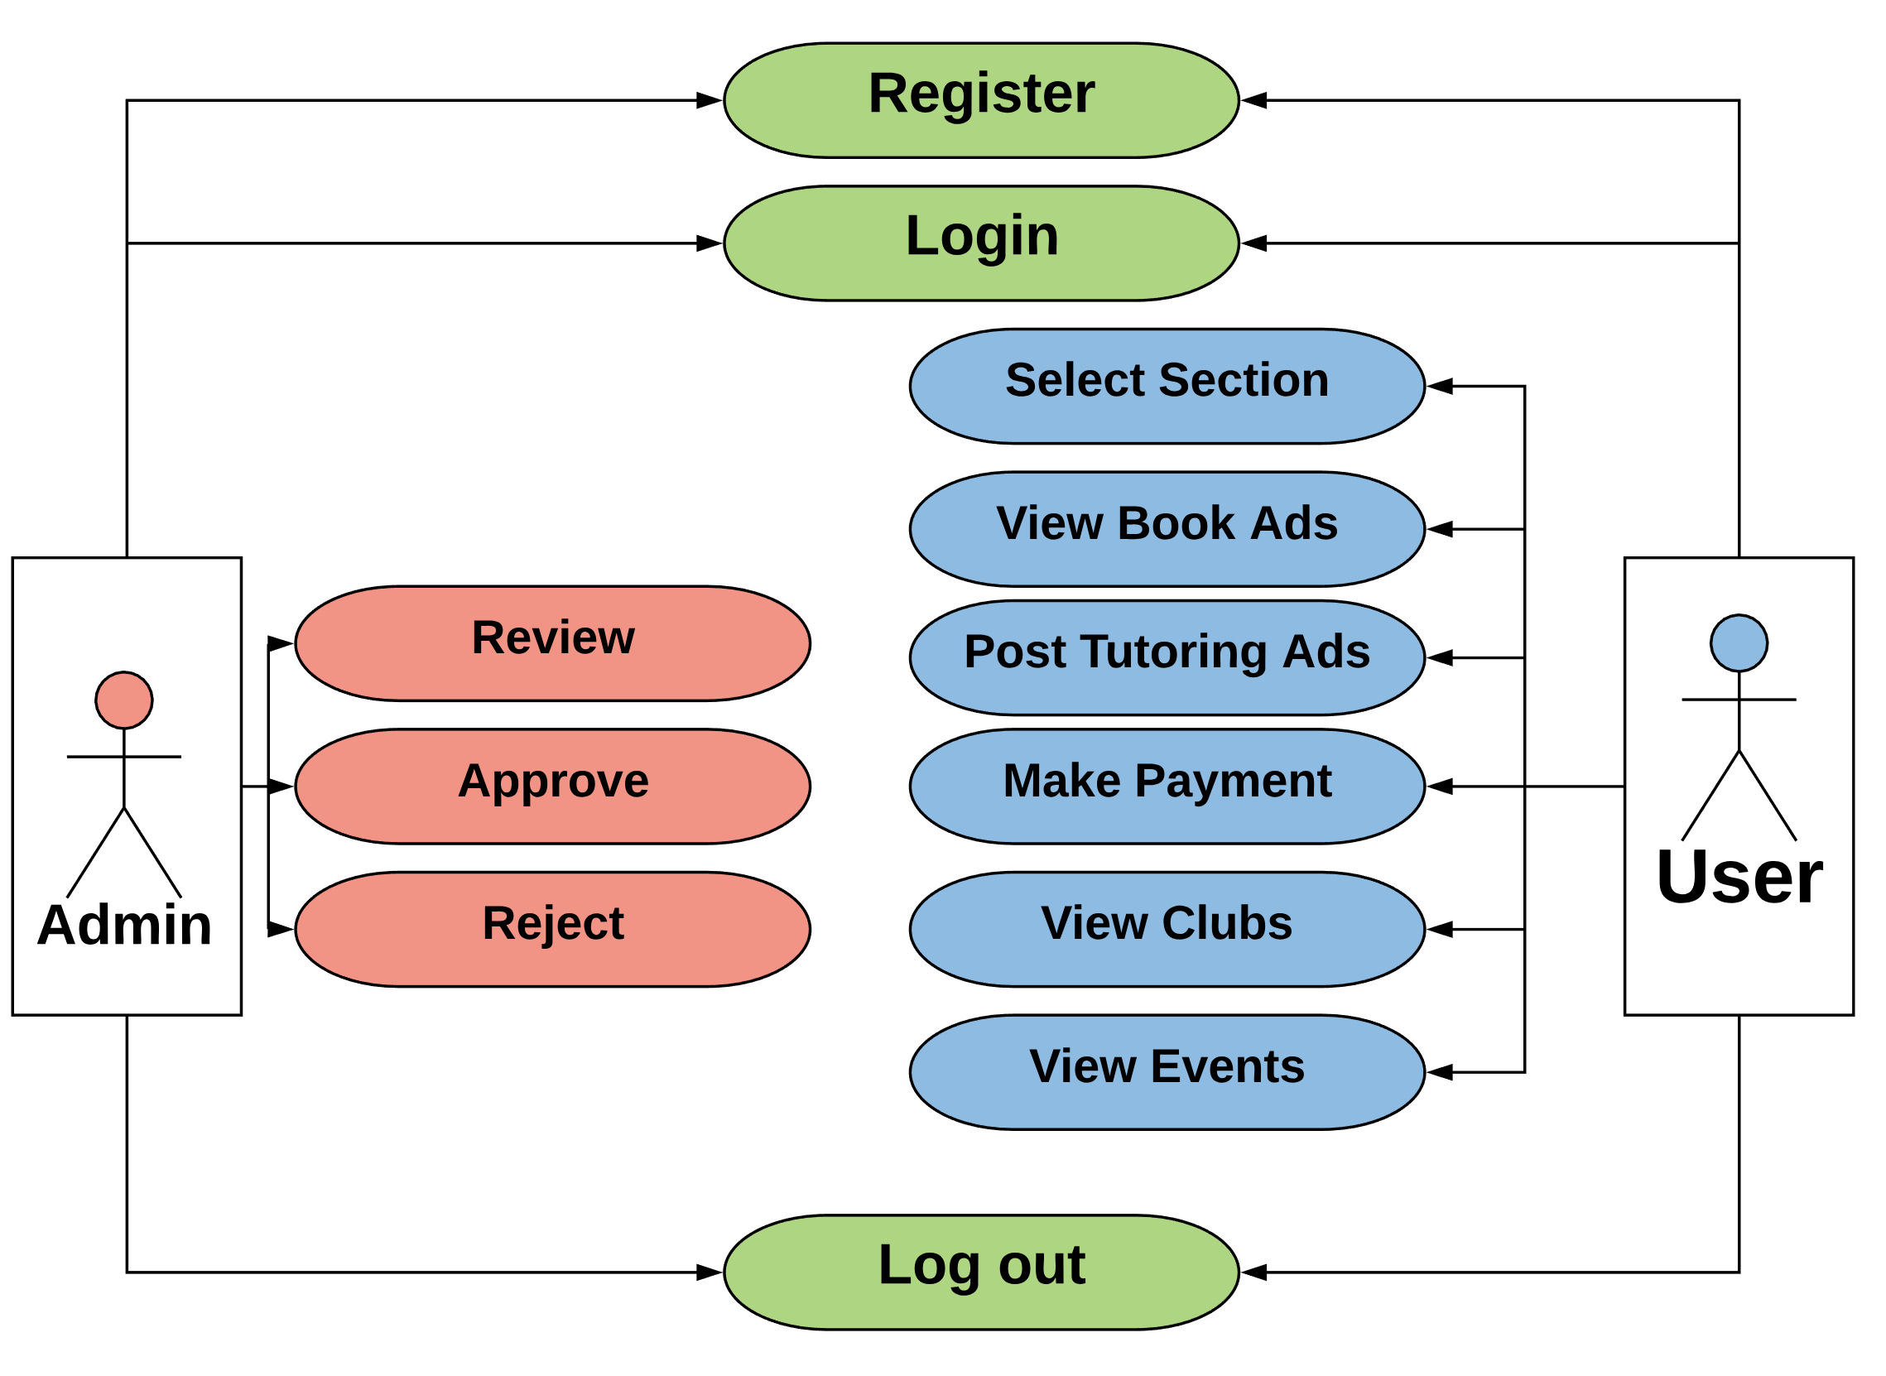

Slide 7
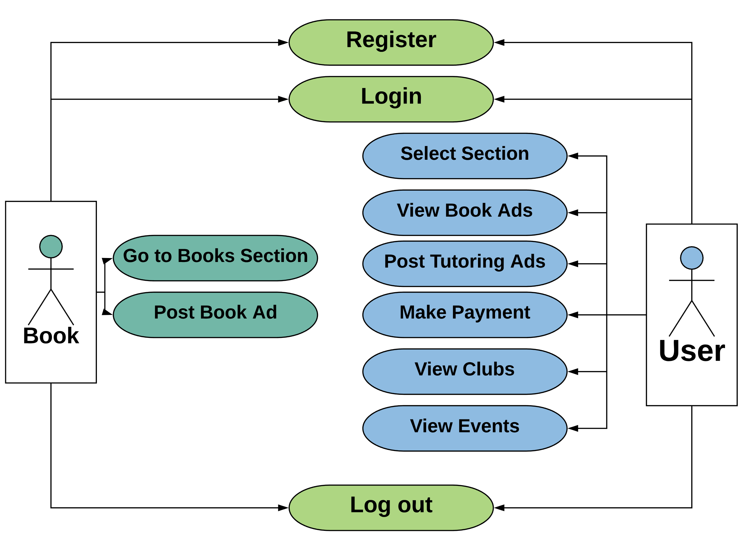

Slide 8
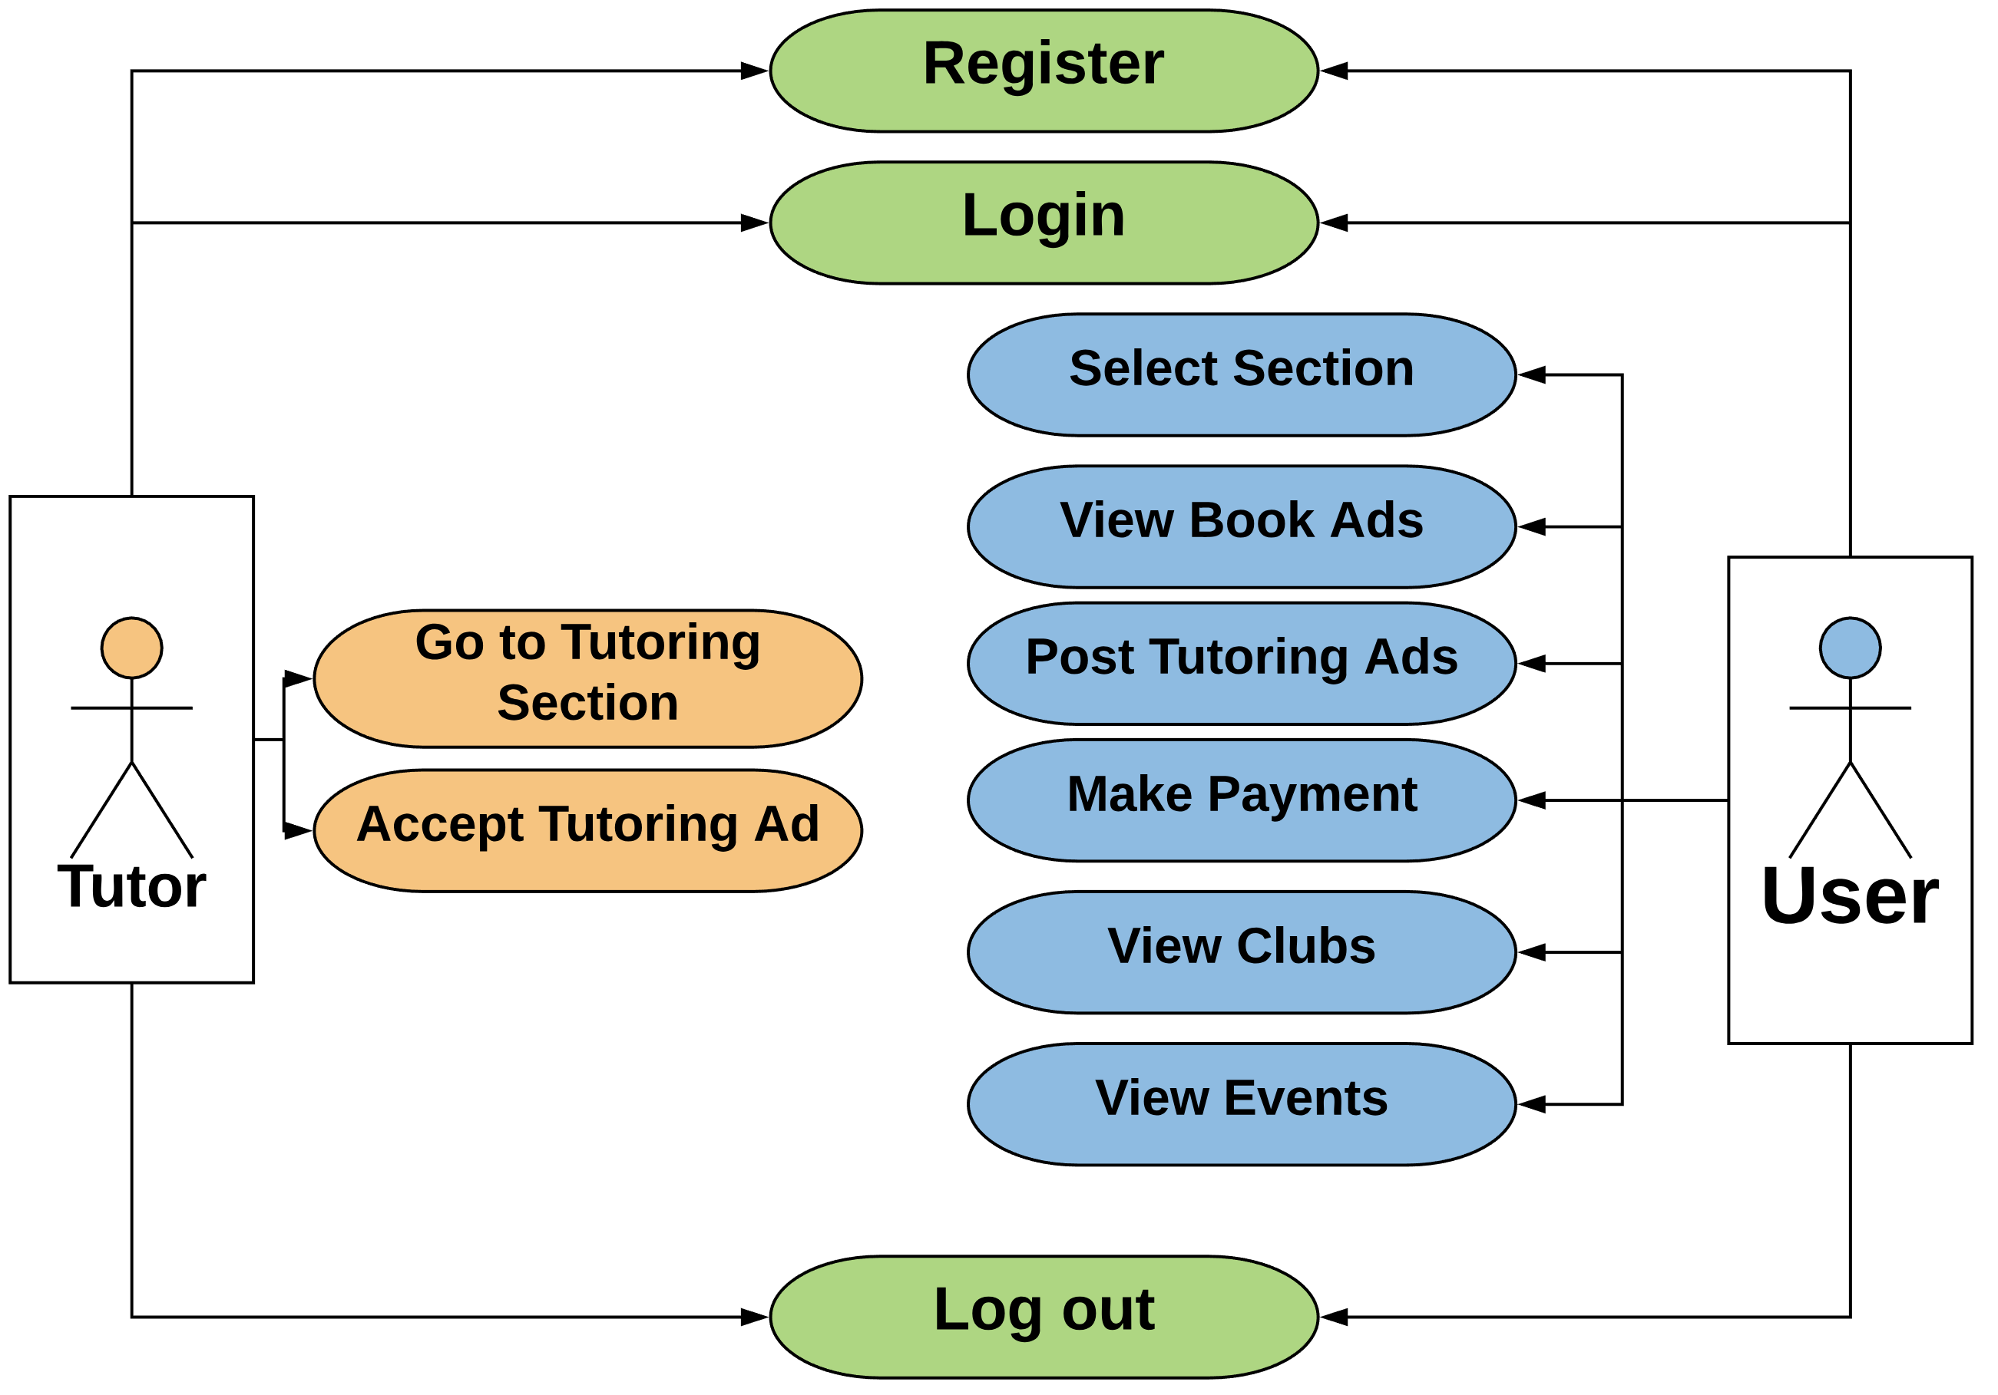

Slide 9
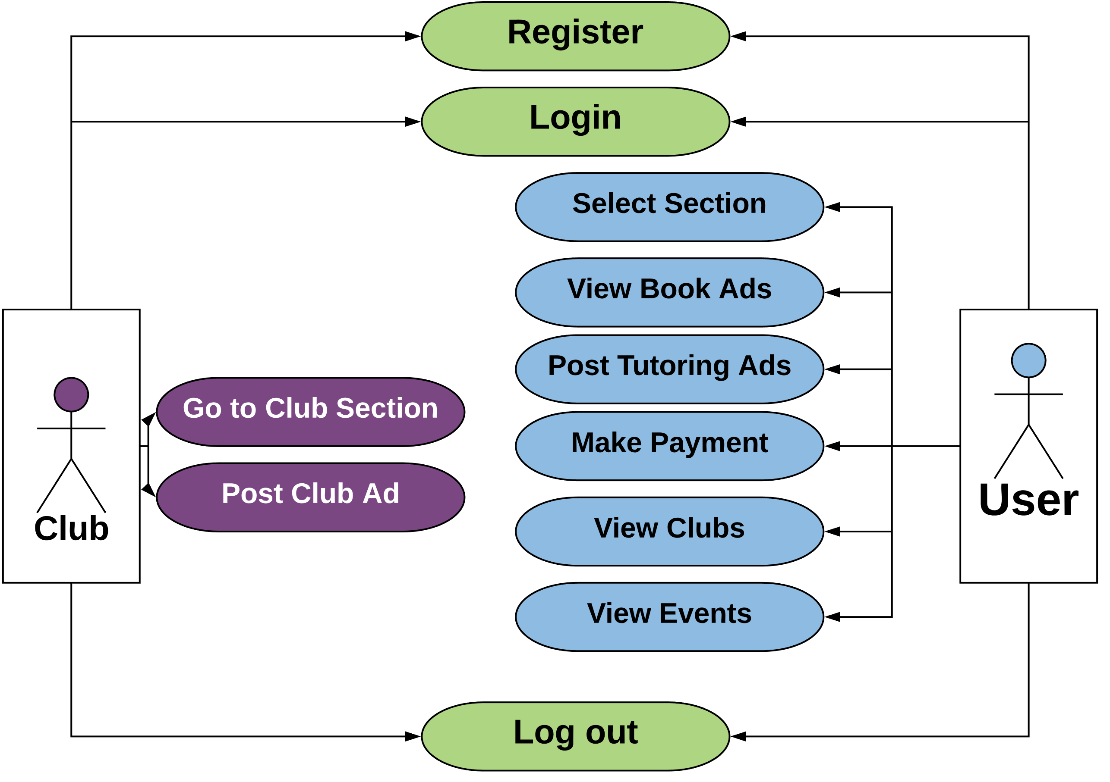

Slide 10
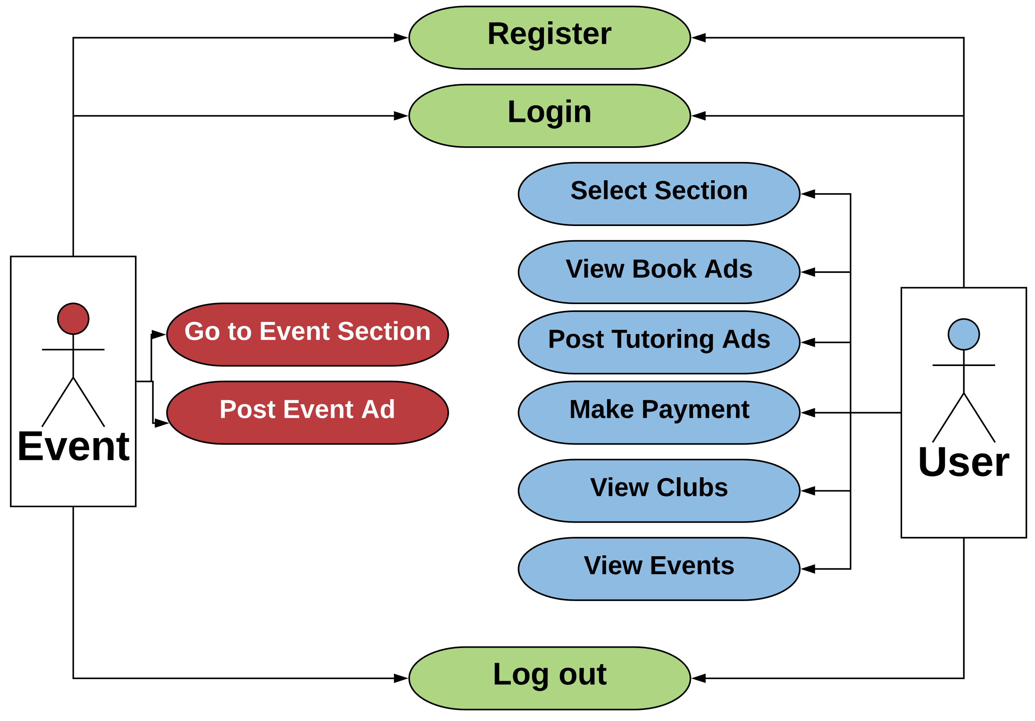

Slide 11
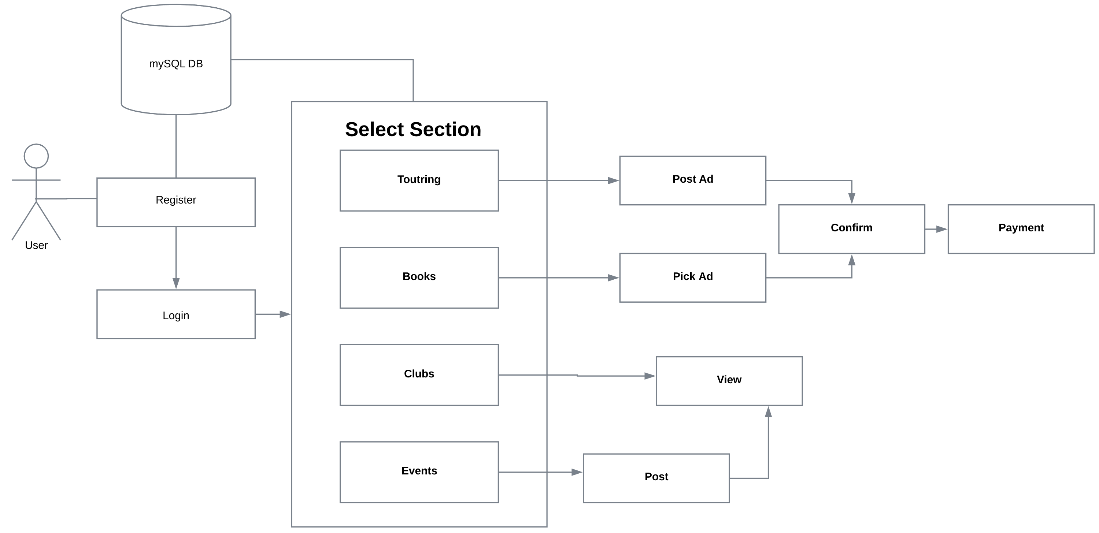
System Diagram

Slide 12
Demo
- Register user.
- Login.
- Tutor Form ( Apply as a Tutor ).
- Club Form ( Apply as a Club member ).
- Admin ( View Tutor and Club Forms ).

Slide 13
Thank You :)

